Slide 1
Introduction to Parallel Computing
Unit 3
Ananth Grama, Anshul Gupta,
George Karypis, and Vipin Kumar
To accompany the text ``Introduction to Parallel Computing'',
Addison Wesley, 2003.

Slide 2
Topic Overview
Motivating Parallelism
Scope of Parallel Computing

Slide 3
Motivating Parallelism
The role of parallelism in accelerating computing speeds has been recognized for several decades.
Its role in providing multiplicity of data paths and increased access to storage elements has been significant in commercial applications.
The scalable performance and lower cost of parallel platforms is reflected in the wide variety of applications.
Processor (CPU) is the active part of the computer, which does all the work of data manipulation and decision making.
Datapath is the hardware that performs all the required data processing operations, for example, ALU, registers, and internal buses.
Control is the hardware that tells the datapath what to do, in terms of switching, operation selection, data movement between ALU components,

Slide 4
Motivating Parallelism
Developing parallel hardware and software has traditionally been time and effort intensive.
If one is to view this in the context of rapidly improving uniprocessor speeds, one is tempted to question the need for parallel computing.
There are some unmistakable trends in hardware design, which indicate that uniprocessor (or implicitly parallel) architectures may not be able to sustain the rate of realizable performance increments in the future.
This is the result of a number of fundamental physical and computational limitations.
The emergence of standardized parallel programming environments, libraries, and hardware have significantly reduced time to (parallel) solution.

Slide 5
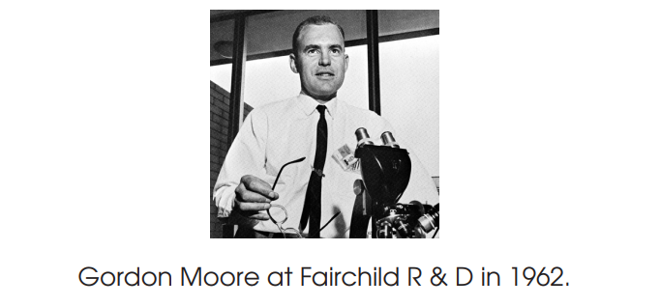
The Computational Power Argument
Moore’s law states [1965]:
“The complexity for minimum component costs has increased at a rate of roughly a factor of two per year. Certainly over the short term this rate can be expected to continue, if not to increase. Over the longer term, the rate of increase is a bit more uncertain, although there is no reason to believe it will not remain nearly constant for at least 10 years. That means by 1975, the number of components per integrated circuit for minimum cost will be 65,000.”

Slide 6
The Computational Power Argument
A simple method for forcing send/receive semantics is for the send operation to return only when it is safe to do so.
In the non-buffered blocking send, the operation does not return until the matching receive has been encountered at the receiving process.
Idling and deadlocks are major issues with non-buffered blocking sends.
In buffered blocking sends, the sender simply copies the data into the designated buffer and returns after the copy operation has been completed. The data is copied at a buffer at the receiving end as well.
Buffering alleviates idling at the expense of copying overheads.

Slide 7
The Computational Power Argument
Moore attributed this doubling rate to exponential behavior of die sizes, finer minimum dimensions, and “circuit and device cleverness”.
In 1975, he revised this law as follows: “There is no room left to squeeze anything out by being clever.
Going forward from here we have to depend on the two size factors - bigger dies and finer dimensions.”
He revised his rate of circuit complexity doubling to 18 months and projected from 1975 onwards at this reduced rate.
A die in the context of integrated circuits is a small block of semiconducting material, on which a given functional circuit is fabricated.
By 2004, clock frequencies had gotten fast enough-around 3 GHz that any further increases would have caused the chips to melt from the heat they generated.
So while the manufacturers continued to increase the number of transistors per chip, they no longer increased the clock frequencies.
Instead, they started putting multiple processor cores on the chip.

Slide 8
The Computational Power Argument
If one is to buy into Moore’s law, the question still remains – how does one translate transistors into useful OPS (operations per second)?
The logical recourse is to rely on parallelism, both implicit and explicit.
Most serial (or seemingly serial) processors rely extensively on implicit parallelism.
We focus in this class, for the most part, on explicit parallelism.
Implicit parallelism is a characteristic of a programming language that allows a compiler or interpreter to automatically exploit the parallelism inherent to the computations expressed by some of the language’s constructs.
A pure implicitly parallel language does not need special directives, operators or functions to enable parallel execution.

Slide 9
The Memory/Disk Speed Argument
While clock rates of high-end processors have increased at roughly 40% per year over the past decade, DRAM access times have only improved at the rate of roughly 10% per year over this interval.
This mismatch in speeds causes significant performance bottlenecks.
• Parallel platforms provide increased bandwidth to the memory system.
• Parallel platforms also provide higher aggregate caches.
• Principles of locality of data reference and bulk access, which guide parallel algorithm design also apply to memory optimization. • Some of the fastest growing applications of parallel computing utilize not their raw computational speed, rather their ability to pump data to memory and disk faster.

Slide 10
The Data Communication Argument
As the network evolves, the vision of the Internet as one large computing platform has emerged.
• This view is exploited by applications such as SETI@home and Folding@home.
• In many other applications (typically databases and data mining) the volume of data is such that they cannot be moved.
• Any analyses on this data must be performed over the network using parallel techniques.
The search for extra terrestrial intelligence (SETI) is the collective name for a number of activities undertaken to search for intelligent extraterrestrial life
Folding@home is a distributed computing project for disease research that simulates protein folding, computational drug design, and other types of molecular dynamics. The project uses the idle processing resources of thousands of personal computers owned by volunteers who have installed the software on their systems

Slide 11
Scope of Parallel Computing Applications
• Parallelism finds applications in very diverse application domains for different motivating reasons.
• These range from improved application performance to cost considerations.

Slide 12
Non-Blocking
Message Passing Operations
The programmer must ensure semantics of the send and receive.
This class of non-blocking protocols returns from the send or receive operation before it is semantically safe to do so.
Non-blocking operations are generally accompanied by a check-status operation.
When used correctly, these primitives are capable of overlapping communication overheads with useful computations.
Message passing libraries typically provide both blocking and non-blocking primitives.

Slide 13
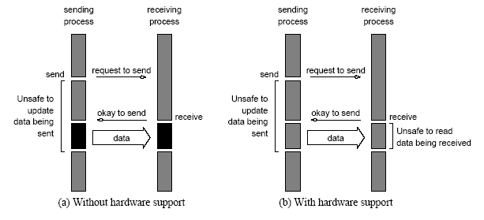
Non-Blocking
Message Passing Operations
Non-blocking non-buffered send and receive operations (a) in
absence of communication hardware; (b) in presence of
communication hardware.

Slide 14
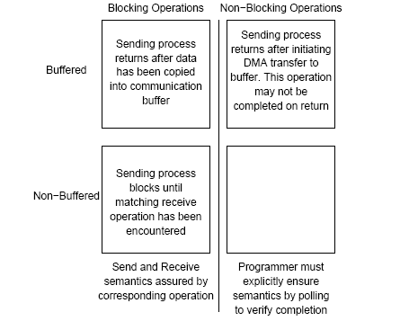
Send and Receive Protocols
Space of possible protocols for send and receive operations.

Slide 15
MPI: the Message Passing Interface
MPI defines a standard library for message-passing that can be used to develop portable message-passing programs using either C or Fortran.
The MPI standard defines both the syntax as well as the semantics of a core set of library routines.
Vendor implementations of MPI are available on almost all commercial parallel computers.
It is possible to write fully-functional message-passing programs by using only the six routines.

Slide 16
MPI: the Message Passing Interface
The minimal set of MPI routines.
MPI_Init | Initializes MPI.
MPI_Finalize | Terminates MPI.
MPI_Comm_size | Determines the number of processes.
MPI_Comm_rank | Determines the label of calling process.
MPI_Send | Sends a message.
MPI_Recv | Receives a message.

Slide 17
Starting and Terminating the MPI Library
MPI_Init is called prior to any calls to other MPI routines. Its purpose is to initialize the MPI environment.
MPI_Finalize is called at the end of the computation, and it performs various clean-up tasks to terminate the MPI environment.
The prototypes of these two functions are:
int MPI_Init(int *argc, char ***argv)
int MPI_Finalize()
MPI_Init also strips off any MPI related command-line arguments.
All MPI routines, data-types, and constants are prefixed by “MPI_”. The return code for successful completion is MPI_SUCCESS.

Slide 18
Communicators
A communicator defines a communication domain - a set of processes that are allowed to communicate with each other.
Information about communication domains is stored in variables of type MPI_Comm.
Communicators are used as arguments to all message transfer MPI routines.
A process can belong to many different (possibly overlapping) communication domains.
MPI defines a default communicator called MPI_COMM_WORLD which includes all the processes.

Slide 19
Querying Information
The MPI_Comm_size and MPI_Comm_rank functions are used to determine the number of processes and the label of the calling process, respectively.
The calling sequences of these routines are as follows:
int MPI_Comm_size(MPI_Comm comm, int *size)
int MPI_Comm_rank(MPI_Comm comm, int *rank)
The rank of a process is an integer that ranges from zero up to the size of the communicator minus one.

Slide 20
Our First MPI Program
#include <mpi.h>
main(int argc, char *argv[])
{
int npes, myrank;
MPI_Init(&argc, &argv);
MPI_Comm_size(MPI_COMM_WORLD, &npes);
MPI_Comm_rank(MPI_COMM_WORLD, &myrank);
printf("From process %d out of %d, Hello World!\n",
myrank, npes);
MPI_Finalize();
}

Slide 21
Sending and Receiving Messages
The basic functions for sending and receiving messages in MPI are the MPI_Send and MPI_Recv, respectively.
The calling sequences of these routines are as follows:
int MPI_Send(void *buf, int count, MPI_Datatype datatype, int dest, int tag, MPI_Comm comm)
int MPI_Recv(void *buf, int count, MPI_Datatype datatype, int source, int tag, MPI_Comm comm, MPI_Status *status)
MPI provides equivalent datatypes for all C datatypes. This is done for portability reasons.
The datatype MPI_BYTE corresponds to a byte (8 bits) and MPI_PACKED corresponds to a collection of data items that has been created by packing non-contiguous data.
The message-tag can take values ranging from zero up to the MPI defined constant MPI_TAG_UB.

Slide 22
MPI Datatypes
MPI Datatype | C Datatype
MPI_CHAR | signed char
MPI_SHORT | signed short int
MPI_INT | signed int
MPI_LONG | signed long int
MPI_UNSIGNED_CHAR | unsigned char
MPI_UNSIGNED_SHORT | unsigned short int
MPI_UNSIGNED | unsigned int
MPI_UNSIGNED_LONG | unsigned long int
MPI_FLOAT | float
MPI_DOUBLE | double
MPI_LONG_DOUBLE | long double
MPI_BYTE
MPI_PACKED

Slide 23
Sending and Receiving Messages
MPI allows specification of wildcard arguments for both source and tag.
If source is set to MPI_ANY_SOURCE, then any process of the communication domain can be the source of the message.
If tag is set to MPI_ANY_TAG, then messages with any tag are accepted.
On the receive side, the message must be of length equal to or less than the length field specified.

Slide 24
Sending and Receiving Messages
On the receiving end, the status variable can be used to get information about the MPI_Recv operation.
The corresponding data structure contains:
  typedef struct MPI_Status {
  int MPI_SOURCE;
  int MPI_TAG;
  int MPI_ERROR; };
The MPI_Get_count function returns the precise count of data items received.
  int MPI_Get_count(MPI_Status *status, MPI_Datatype datatype, int *count)

Slide 25
Avoiding Deadlocks
Consider:
int a[10], b[10], myrank;
MPI_Status status;
...
MPI_Comm_rank(MPI_COMM_WORLD, &myrank);
if (myrank == 0) {
MPI_Send(a, 10, MPI_INT, 1, 1, MPI_COMM_WORLD);
MPI_Send(b, 10, MPI_INT, 1, 2, MPI_COMM_WORLD);
}
else if (myrank == 1) {
MPI_Recv(b, 10, MPI_INT, 0, 2, MPI_COMM_WORLD);
MPI_Recv(a, 10, MPI_INT, 0, 1, MPI_COMM_WORLD);
}
...
If MPI_Send is blocking, there is a deadlock.

Slide 26
Avoiding Deadlocks
Consider the following piece of code, in which process i sends a message to process i + 1 (modulo the number of processes) and receives a message from process i - 1 (module the number of processes).
int a[10], b[10], npes, myrank;
MPI_Status status;
...
MPI_Comm_size(MPI_COMM_WORLD, &npes);
MPI_Comm_rank(MPI_COMM_WORLD, &myrank);
MPI_Send(a, 10, MPI_INT, (myrank+1)%npes, 1, MPI_COMM_WORLD);
MPI_Recv(b, 10, MPI_INT, (myrank-1+npes)%npes, 1, MPI_COMM_WORLD);
...
Once again, we have a deadlock if MPI_Send is blocking.

Slide 27
Avoiding Deadlocks
We can break the circular wait to avoid deadlocks as follows:
int a[10], b[10], npes, myrank;
MPI_Status status;
...
MPI_Comm_size(MPI_COMM_WORLD, &npes);
MPI_Comm_rank(MPI_COMM_WORLD, &myrank);
if (myrank%2 == 1) {
MPI_Send(a, 10, MPI_INT, (myrank+1)%npes, 1, MPI_COMM_WORLD);
MPI_Recv(b, 10, MPI_INT, (myrank-1+npes)%npes, 1, MPI_COMM_WORLD);
}
else {
MPI_Recv(b, 10, MPI_INT, (myrank-1+npes)%npes, 1, MPI_COMM_WORLD);
MPI_Send(a, 10, MPI_INT, (myrank+1)%npes, 1, MPI_COMM_WORLD);
}
...

Slide 28
Sending and Receiving
Messages Simultaneously
To exchange messages, MPI provides the following function:
int MPI_Sendrecv(void *sendbuf, int sendcount,
MPI_Datatype senddatatype, int dest, int sendtag, void *recvbuf, int recvcount, MPI_Datatype recvdatatype, int source, int recvtag, MPI_Comm comm, MPI_Status *status)
The arguments include arguments to the send and receive
functions. If we wish to use the same buffer for both send and
receive, we can use:
int MPI_Sendrecv_replace(void *buf, int count,
MPI_Datatype datatype, int dest, int sendtag,
int source, int recvtag, MPI_Comm comm,
MPI_Status *status)

Slide 29
Topologies and Embeddings
MPI allows a programmer to organize processors into logical k-d meshes.
The processor ids in MPI_COMM_WORLD can be mapped to other communicators (corresponding to higher-dimensional meshes) in many ways.
The goodness of any such mapping is determined by the interaction pattern of the underlying program and the topology of the machine.
MPI does not provide the programmer any control over these mappings.

Slide 30
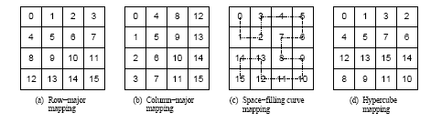
Topologies and Embeddings
Different ways to map a set of processes to a two-dimensional
grid. (a) and (b) show a row- and column-wise mapping of these
processes, (c) shows a mapping that follows a space-lling curve
(dotted line), and (d) shows a mapping in which neighboring
processes are directly connected in a hypercube.

Slide 31
Creating and Using
Cartesian Topologies
We can create cartesian topologies using the function:
  int MPI_Cart_create(MPI_Comm comm_old, int ndims,
  int *dims, int *periods, int reorder, MPI_Comm *comm_cart)
This function takes the processes in the old communicator and creates a new communicator with dims dimensions.
Each processor can now be identified in this new cartesian topology by a vector of dimension dims.

Slide 32
Creating and Using
Cartesian Topologies
Since sending and receiving messages still require (one-dimensional) ranks, MPI provides routines to convert ranks to cartesian coordinates and vice-versa.
  int MPI_Cart_coord(MPI_Comm comm_cart, int rank, int maxdims, int *coords)
  int MPI_Cart_rank(MPI_Comm comm_cart, int *coords, int *rank)
The most common operation on cartesian topologies is a shift. To determine the rank of source and destination of such shifts, MPI provides the following function:
  int MPI_Cart_shift(MPI_Comm comm_cart, int dir, int s_step, int *rank_source, int *rank_dest)

Slide 33
Overlapping Communication with Computation
In order to overlap communication with computation, MPI provides a pair of functions for performing non-blocking send and receive operations.
  int MPI_Isend(void *buf, int count, MPI_Datatype datatype,
  int dest, int tag, MPI_Comm comm,
  MPI_Request *request)
  int MPI_Irecv(void *buf, int count, MPI_Datatype datatype,
  int source, int tag, MPI_Comm comm,
  MPI_Request *request)
These operations return before the operations have been completed. Function MPI_Test tests whether or not the non-blocking send or receive operation identified by its request has finished.
  int MPI_Test(MPI_Request *request, int *flag,
  MPI_Status *status)
MPI_Wait waits for the operation to complete.
  int MPI_Wait(MPI_Request *request, MPI_Status *status)

Slide 34
Avoiding Deadlocks
Using non-blocking operations remove most deadlocks. Consider:
int a[10], b[10], myrank;
MPI_Status status;
...
MPI_Comm_rank(MPI_COMM_WORLD, &myrank);
if (myrank == 0) {
MPI_Send(a, 10, MPI_INT, 1, 1, MPI_COMM_WORLD);
MPI_Send(b, 10, MPI_INT, 1, 2, MPI_COMM_WORLD);
}
else if (myrank == 1) {
MPI_Recv(b, 10, MPI_INT, 0, 2, &status, MPI_COMM_WORLD); MPI_Recv(a, 10, MPI_INT, 0, 1, &status, MPI_COMM_WORLD);
}
...
Replacing either the send or the receive operations with non-blocking counterparts fixes this deadlock.

Slide 35
Collective Communication and Computation Operations
MPI provides an extensive set of functions for performing common collective communication operations.
Each of these operations is defined over a group corresponding to the communicator.
All processors in a communicator must call these operations.

Slide 36
Collective Communication Operations
The barrier synchronization operation is performed in MPI using:
  int MPI_Barrier(MPI_Comm comm)
The one-to-all broadcast operation is:
  int MPI_Bcast(void *buf, int count, MPI_Datatype datatype, int source, MPI_Comm comm)
The all-to-one reduction operation is:
  int MPI_Reduce(void *sendbuf, void *recvbuf, int count, MPI_Datatype datatype, MPI_Op op, int target, MPI_Comm comm)

Slide 37
Predefined Reduction Operations
Operation | Meaning | Datatypes
MPI_MAX | Maximum | C integers and floating point
MPI_MIN | Minimum | C integers and floating point
MPI_SUM | Sum | C integers and floating point
MPI_PROD | Product | C integers and floating point
MPI_LAND | Logical AND | C integers
MPI_BAND | Bit-wise AND | C integers and byte
MPI_LOR | Logical OR | C integers
MPI_BOR | Bit-wise OR | C integers and byte
MPI_LXOR | Logical XOR | C integers
MPI_BXOR | Bit-wise XOR | C integers and byte
MPI_MAXLOC | max-min value-location | Data-pairs
MPI_MINLOC | min-min value-location | Data-pairs

Slide 38
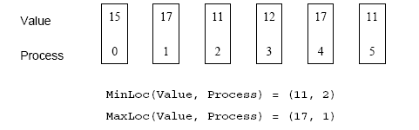
Collective Communication Operations
The operation MPI_MAXLOC combines pairs of values (v_{i}, l_{i}) and returns the pair (v, l) such that v is the maximum among all v_{i} 's and l is the corresponding l_{i} (if there are more than one, it is the smallest among all these l_{i} 's).
MPI_MINLOC does the same, except for minimum value of v_{i}.
An example use of the MPI_MINLOC and MPI_MAXLOC operators.

Slide 39
Collective Communication Operations
MPI datatypes for data-pairs used with the MPI_MAXLOC and MPI_MINLOC reduction operations.
MPI Datatype | C Datatype
MPI_2INT | pair of ints
MPI_SHORT_INT | short and int
MPI_LONG_INT | long and int
MPI_LONG_DOUBLE_INT | long double and int
MPI_FLOAT_INT | float and int
MPI_DOUBLE_INT | double and int

Slide 40
Collective Communication Operations
If the result of the reduction operation is needed by all processes, MPI provides:
  int MPI_Allreduce(void *sendbuf, void *recvbuf,
  int count, MPI_Datatype datatype, MPI_Op op, MPI_Comm comm)
To compute prefix-sums, MPI provides:
  int MPI_Scan(void *sendbuf, void *recvbuf, int count, MPI_Datatype datatype, MPI_Op op,
  MPI_Comm comm)

Slide 41
Collective Communication Operations
The gather operation is performed in MPI using:
  int MPI_Gather(void *sendbuf, int sendcount,
  MPI_Datatype senddatatype, void *recvbuf,
  int recvcount, MPI_Datatype recvdatatype,
  int target, MPI_Comm comm)
MPI also provides the MPI_Allgather function in which the data are gathered at all the processes.
  int MPI_Allgather(void *sendbuf, int sendcount, MPI_Datatype senddatatype, void *recvbuf,
  int recvcount, MPI_Datatype recvdatatype,
  MPI_Comm comm)
The corresponding scatter operation is:
  int MPI_Scatter(void *sendbuf, int sendcount,
  MPI_Datatype senddatatype, void *recvbuf,
  int recvcount, MPI_Datatype recvdatatype,
  int source, MPI_Comm comm)

Slide 42
Collective Communication Operations
The all-to-all personalized communication operation is performed by:
  int MPI_Alltoall(void *sendbuf, int sendcount, MPI_Datatype senddatatype, void *recvbuf,
  int recvcount, MPI_Datatype recvdatatype, MPI_Comm comm)
Using this core set of collective operations, a number of programs can be greatly simplified.

Slide 43
Groups and Communicators
In many parallel algorithms, communication operations need to be restricted to certain subsets of processes.
MPI provides mechanisms for partitioning the group of processes that belong to a communicator into subgroups each corresponding to a different communicator.
The simplest such mechanism is:
  int MPI_Comm_split(MPI_Comm comm, int color, int key, MPI_Comm *newcomm)
This operation groups processors by color and sorts resulting groups on the key.

Slide 44
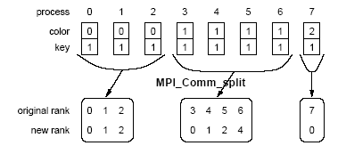
Groups and Communicators
Using MPI_Comm_split to split a group of processes in a communicator into subgroups.

Slide 45
Groups and Communicators
In many parallel algorithms, processes are arranged in a virtual grid, and in different steps of the algorithm, communication needs to be restricted to a different subset of the grid.
MPI provides a convenient way to partition a Cartesian topology to form lower-dimensional grids:
  int MPI_Cart_sub(MPI_Comm comm_cart, int *keep_dims, MPI_Comm *comm_subcart)
If keep_dims[i] is true (non-zero value in C) then the ith dimension is retained in the new sub-topology.
The coordinate of a process in a sub-topology created by MPI_Cart_sub can be obtained from its coordinate in the original topology by disregarding the coordinates that correspond to the dimensions that were not retained.

Slide 46
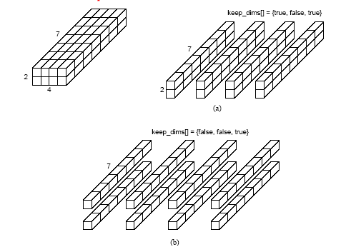
Groups and Communicators
Splitting a Cartesian topology of size 2 x 4 x 7 into (a) four
subgroups of size 2 x 1 x 7, and (b) eight subgroups of size 1 x 1 x 7.

